Slide 1

Visualization of the dependence of the
occurrence of
schizophrenia psychical deviations
on the standard of living of citizens of Kazakhstan
Presented by Moldir Satybaldiyeva

Slide 2

WHY IS THIS IMPORTANT?
Schizophrenia causes psychosis, is associated with complete disability, and can have negative consequences for all areas of life, including personal, family, conscious life, and educational and work activities. Individuals with schizophrenia are often victims of stigma, global and societal human rights.

Slide 3
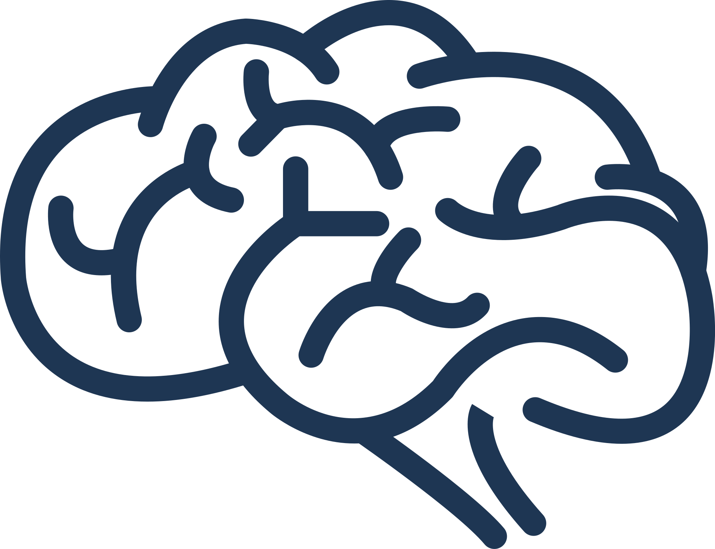
RESEARCH HYPOTHESIS
40
30
1)In different regions of Kazakhstan, the number of psychologists and psychiatric hospitals varies greatly
2)in some regions, they try to treat the early stage in traditional ways instead of going to the doctor
3)Also, factors contributing to the development of schizophrenia include:
difficult childbirth; unfavorable social conditions of life;
physical abuse experienced in childhood;
alcoholism, drug addiction, addiction to hallucinogenic and stimulant drugs.
20
10
0

Slide 4
SOLUTION
Find a pattern using the statistics of psychological hospitals in each region of Kazakhstan, include statistics on child abuse and the standard of living in each region, which are the causes of psychological deviations in people.

Slide 5



DATASET
UNISEF.ORG
Ministry of health of therepublic of Kazakhstan
Tengrinews

Slide 6
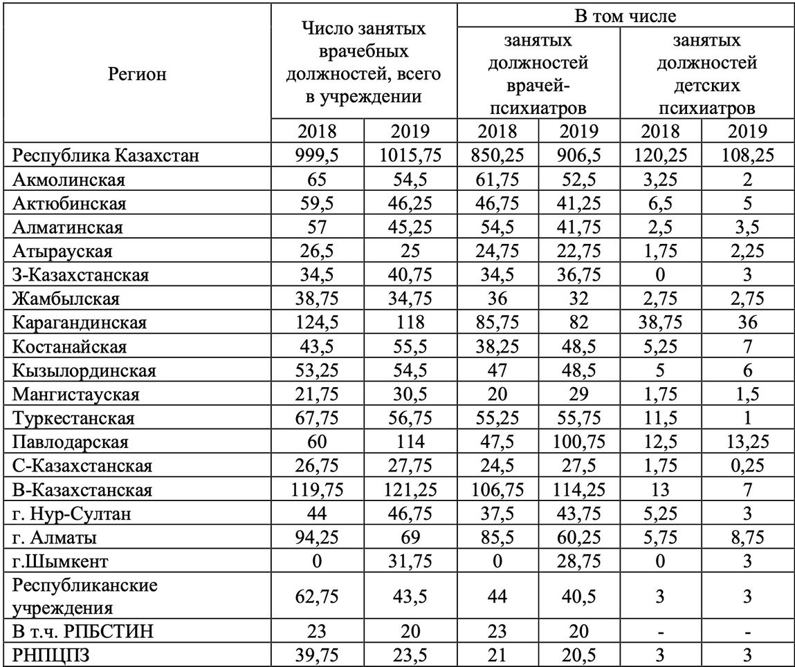
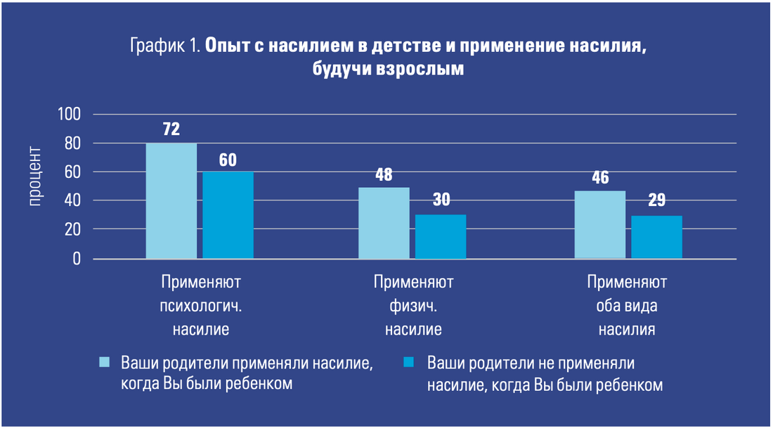
DATASET FROM MINISTRY OF HEALTH OF THE REPUBLIC OF KAZAKHSTAN
DATASET FROM UNISEF
ABOUT DOMESTIC VIOLENCE AGAINST CHILDREN
Medical personnel

